Slide 1
What is it that women truly want?
The wife of Bath teaches a lesson
Joyce Verschoor
Lotte Vermeulen
Hanneke Boon

Slide 2
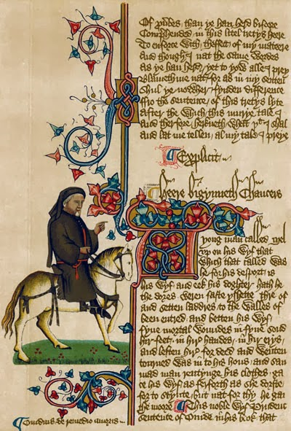
A piece of manuscript
Ellesmere manuscript
Huntington Library,
San Marino
MS EL 26 C 9,
folio 1 verso
http://3.bp.blogspot.com/-3x4s1CnvxFg/UtEkwWc
bCJI/AAAAAAAAGu0/
AOkk3uIwg2Q/s1600/chau
cer+palace.jpg

Slide 3
Exercise 1 Question about text 1
“I’ll grant you life if you can tell me what it is that women most desire.” (r. 904-905)
What do you think that women most desire nowadays?

Slide 4
Boys vs. Girls Question about text 2
What did women most desire in the Middle Ages?

Slide 5
Exercise 2
Questions about text 3
How does the knight feel about the woman?
* How does the woman feel about the knight?

Slide 6
Optional questions exercise 2
*How do we feel about beauty standards nowadays?
*Are they similar to the medieval beauty standards?

Slide 7
Exercise 3 Question about text 4
What are the options the knight can choose from?

Slide 8
Discussion in groups
What would be the best choice according to you?
What do you think the knight will choose?

Slide 9
Answers According to text 5
According to the text, women most desire to have the complete mastery over their own and their husbands lives
The knight does not choose, but gives his wife the mastery

Slide 10
If you were a teacher
* If you were to make an assignment about this story, what questions would you ask?

Slide 11
Thank you for your attention!

